Slide 1
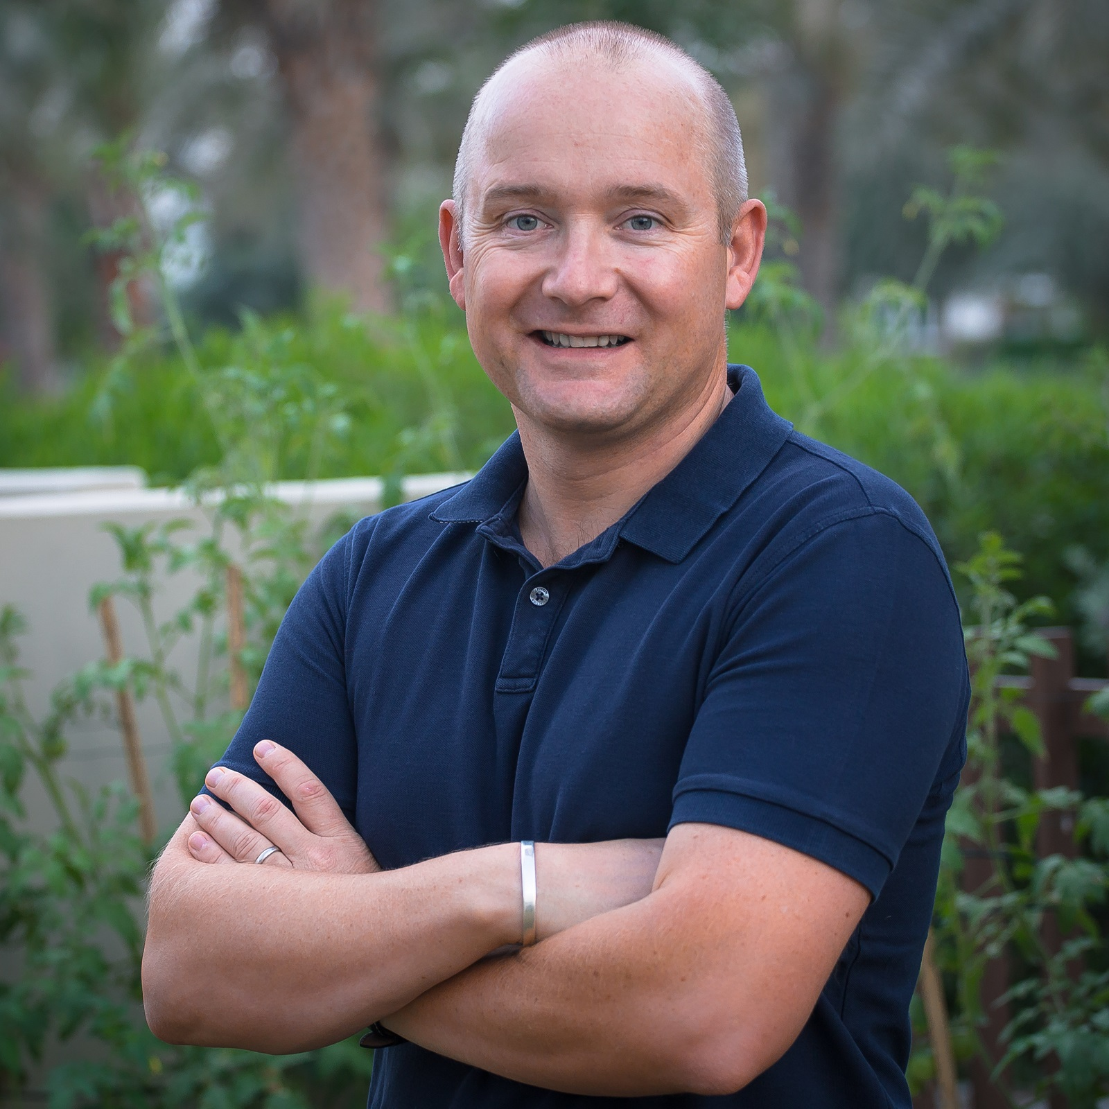
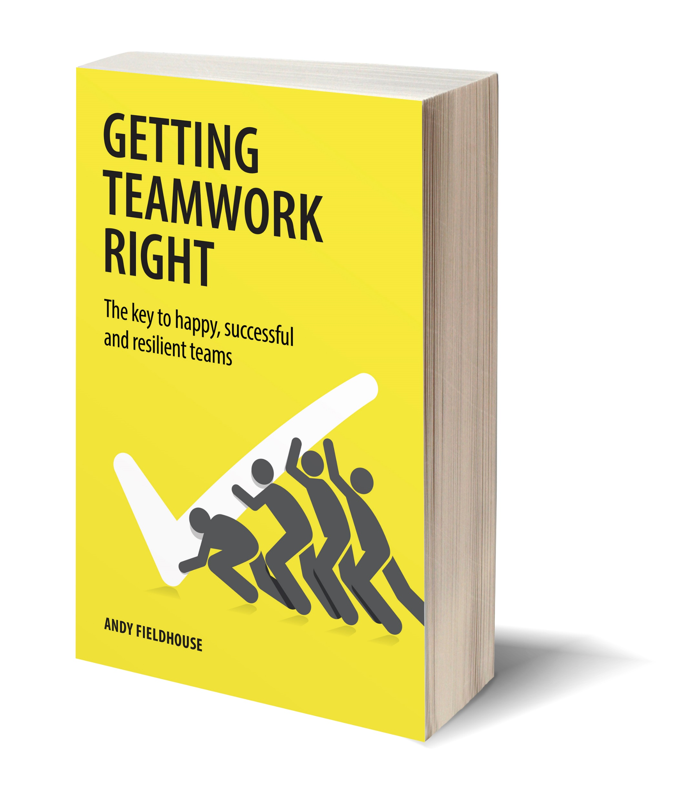
PROFILE: ANDY FIELDHOUSE Author of ‘Getting Teamwork Right’
Andy Fieldhouse is a man with a mission: To help people get teamwork right. Andy is passionately inter­ested in helping people and teams answer the funda­mental question: ‘How can we become a strong, cohesive and successful team, while avoiding the pain that poor teamwork can bring along the way?
After completing a degree in Asian History at London University’s School of Oriental and African Studies, Andy spent the first fourteen years of his career in London, working in the wine trade, financial recruit­ment, and sports marketing and events, in a variety of roles. This foundation allowed Andy to observe, engage with and manage teams from the inside, fig­uring out what makes them tick.
By 2008, Andy had decided he wanted to turn his pas­sion for and knowledge of teams and teamwork into a career. He joined Dubai-based training and team building company Biz Group, where he ran the team performance arm of the business. In late 2016, Andy set up The Team Space, using his experience to train and coach teams to help them to get teamwork right. He no longer thinks of his work as a job but instead as a mission or calling to empower teams to reach a state where the experience of working together is a happy and rewarding one and success comes as a result.
In 2020 Andy published his first book, ‘Getting Teamwork Right’, in order to give people a useful ‘how to’ guide to the ins and outs of effective teamwork, which became a number 1 best seller on Amazon.
Originally from the UK, Andy lives in Dubai with his Australian wife Tanya and their two children. When not working or enjoying time with his family, Andy enjoys the odd round of golf or catching up on read­ing history books.
To find out more please visit www.theteamspace.com
You may also be interested in www.theteamspace.com/blog
Contact Details:
Email: andy@theteamspace.com
Phone: +971 (0)50 559 5711
Linkedin: www.linkedin.com/in/andrewfieldhouse1

